Slide 1
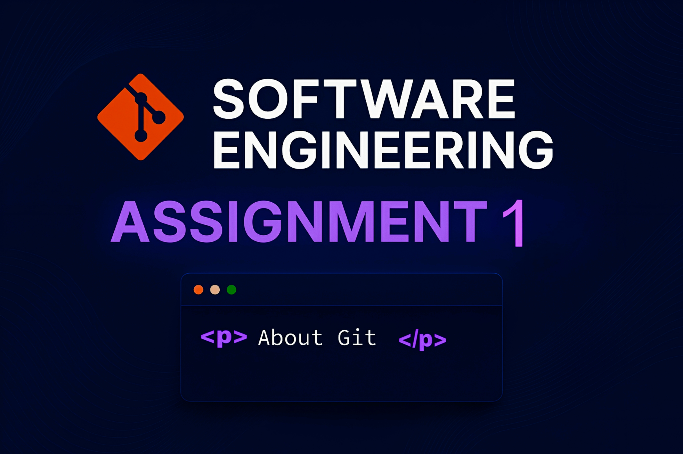

Slide 2
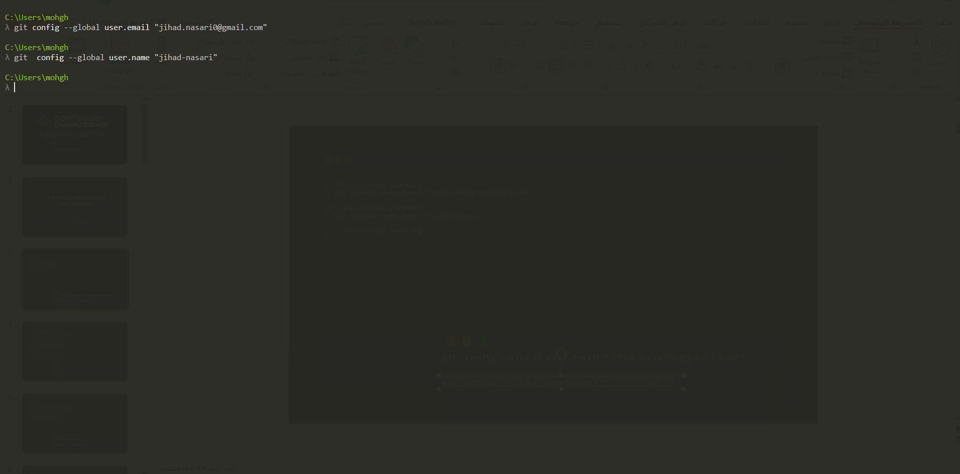
git config --global user.email “jihad.nasari0@gmail.com”
git config --global user.name “jihad-nasari"

Slide 3
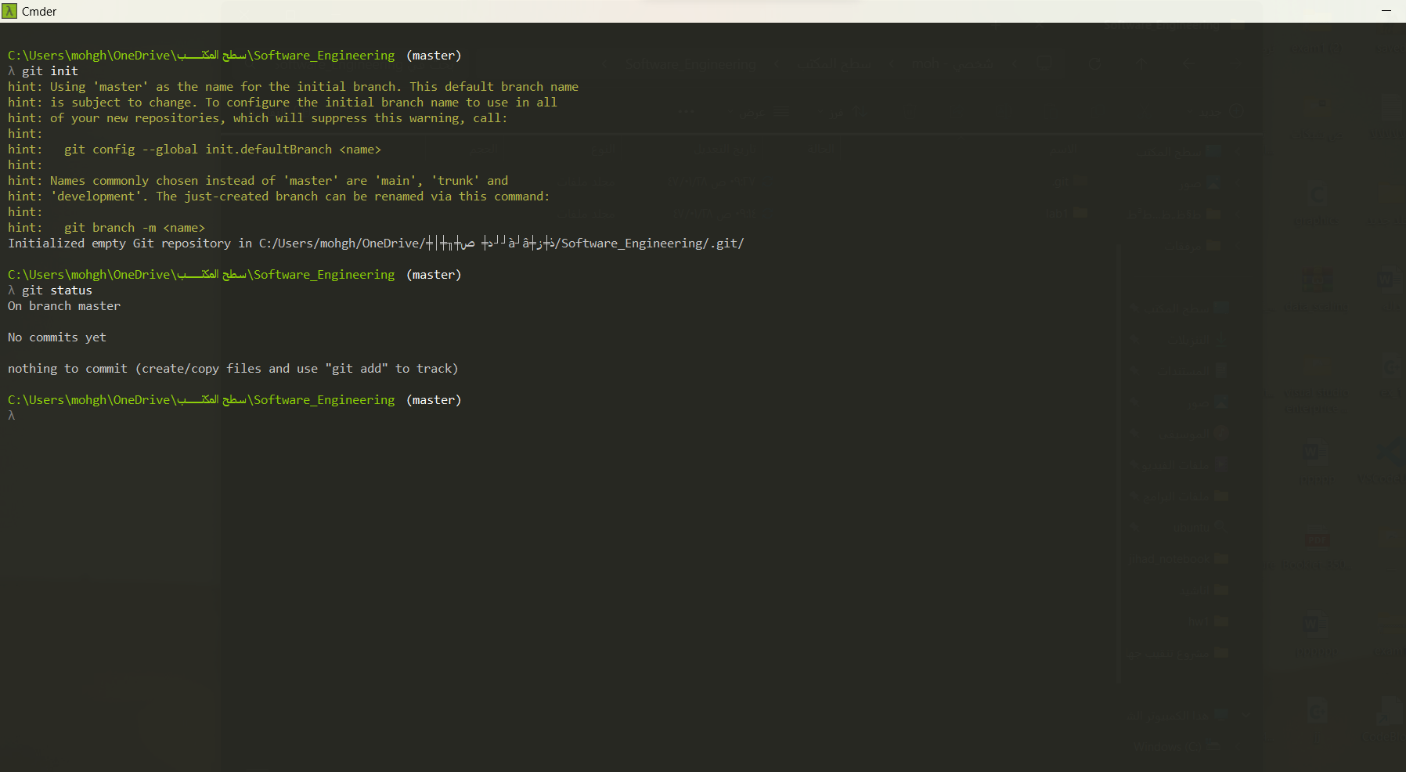
git inti
git status

Slide 4
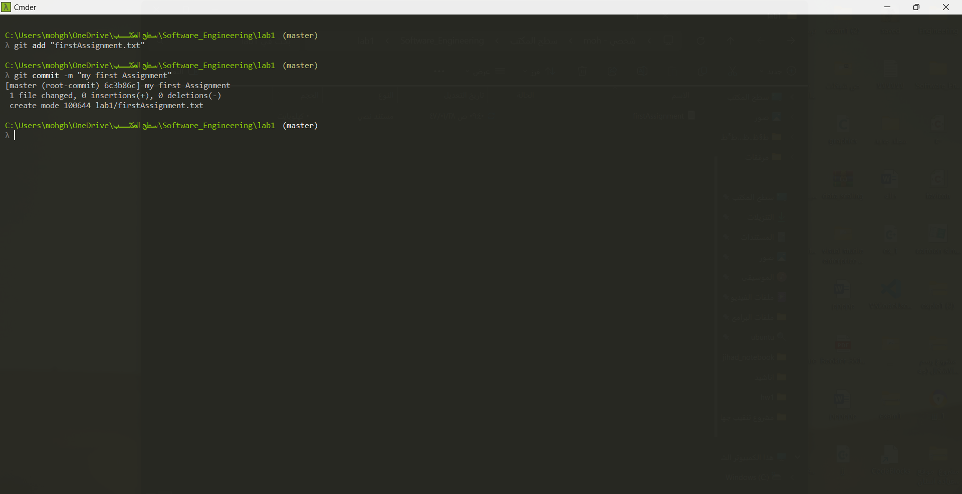
git add "firstAssignment.txt"
git commit –m "firstAssignment.txt"

Slide 5
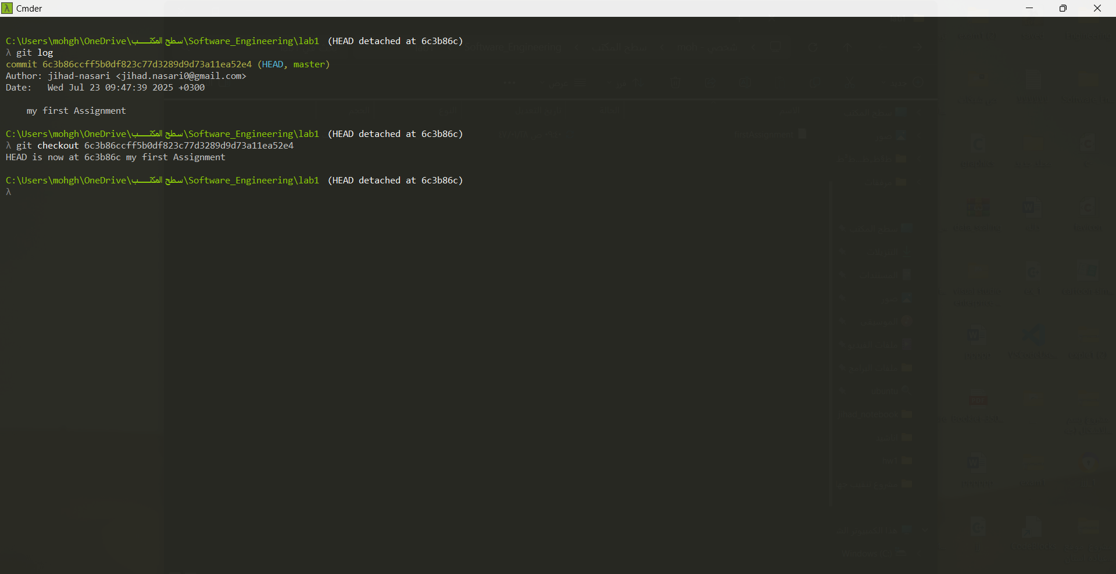
git log
git checkout 6c3b86ccff5b0df823c77d3289d9d73a11ea52e4

Slide 6
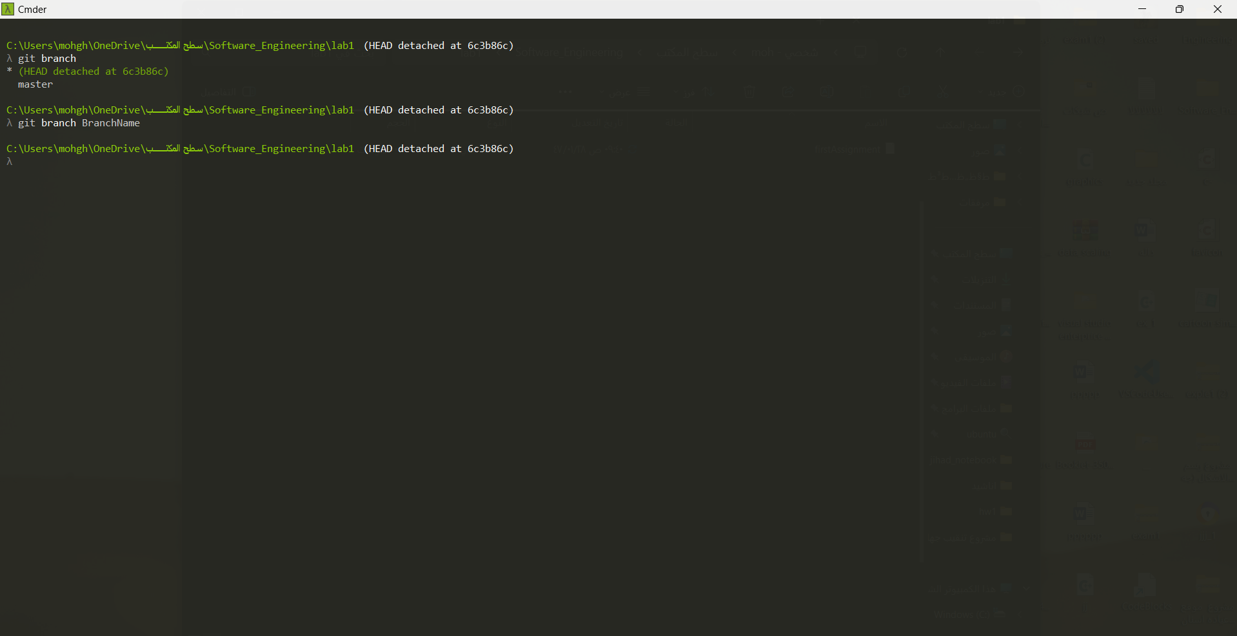
git branch
git branch BranchName

Slide 7
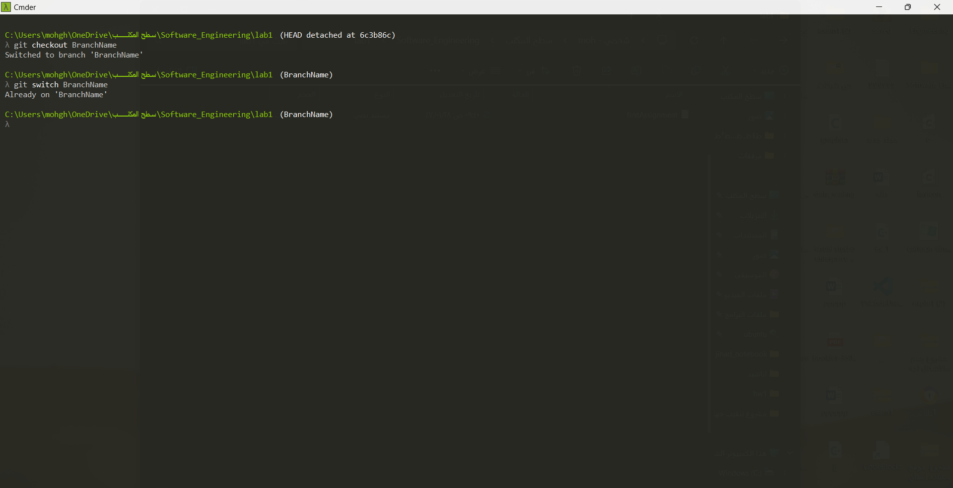
git checkout BranchName
git switch BranchName

Slide 8
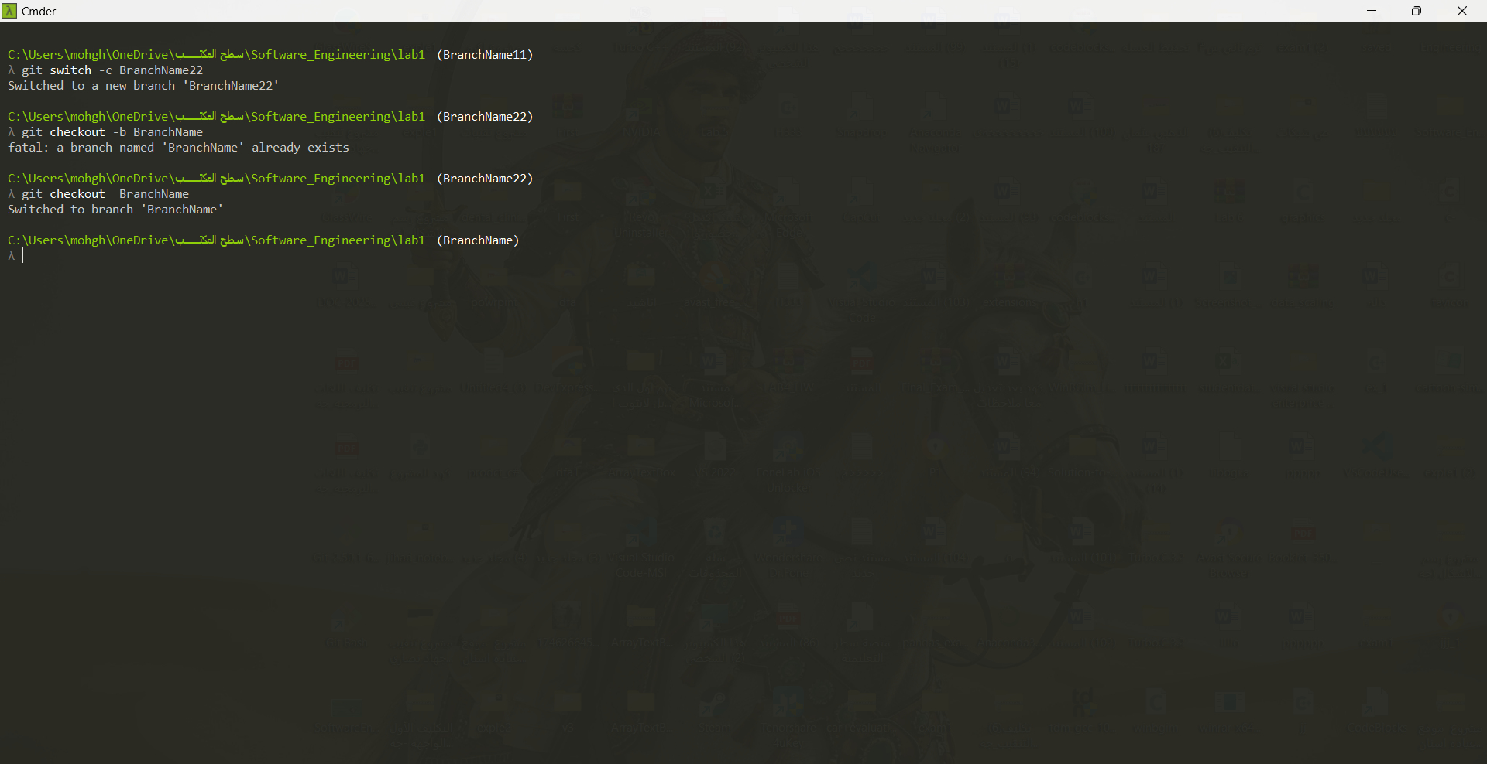
git switch -c BranchName22
git checkout BranchName

Slide 9
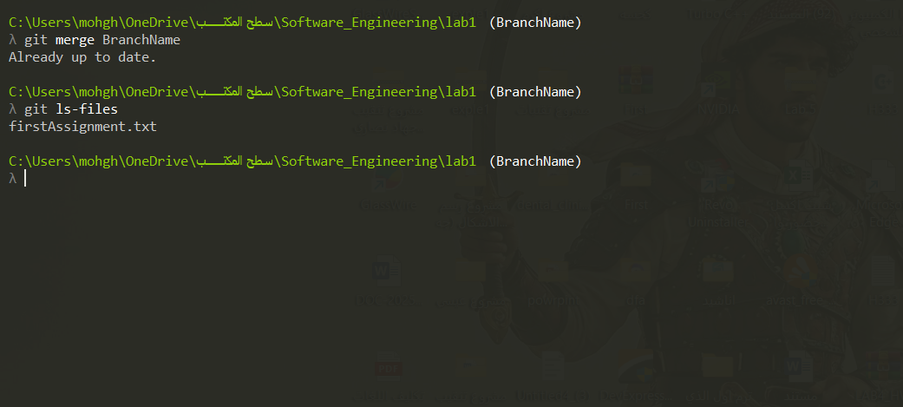
git merge BranchName
git ls-files

Slide 10
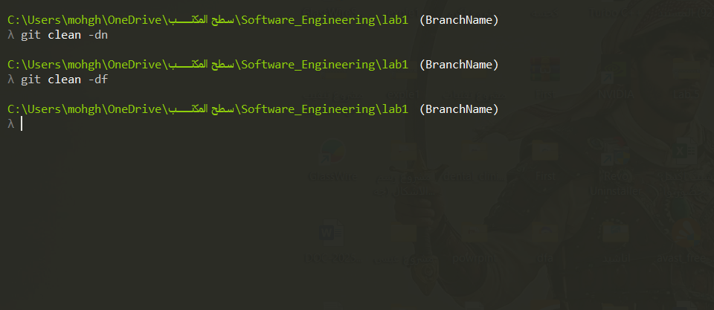
git clean -dn
git clean -df

Slide 11
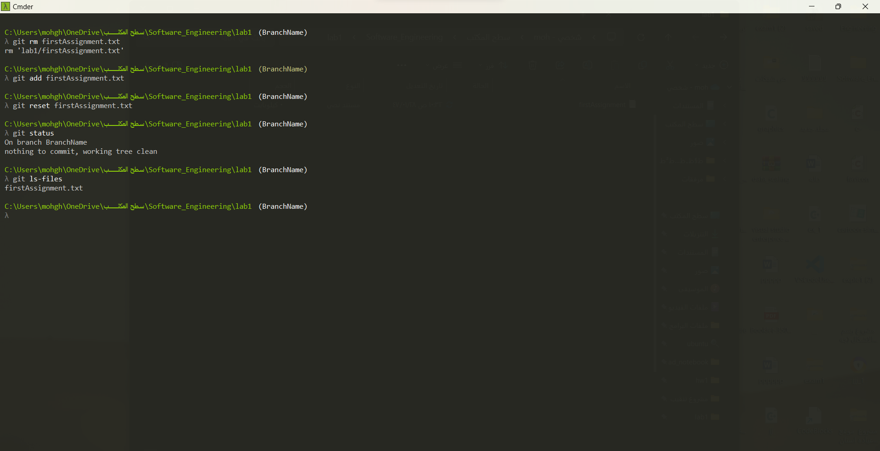
git rm firstAssignment.txt
git reset "firstAssignment.txt"

Slide 12
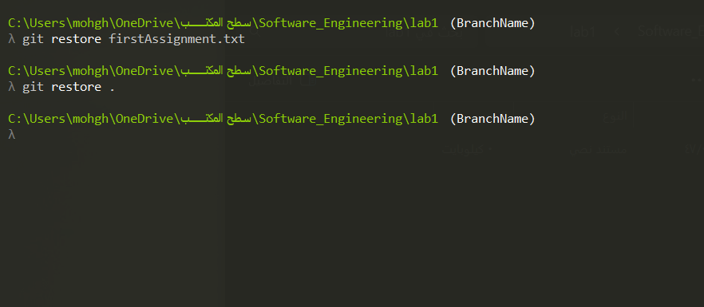
git restore "firstAssignment.txt"
git restore .

Slide 13

THANK YOU.
jihad.nasari@gmail.com
github.com/ Jihad_Nasari

